Slide 1

Innovative Technology Cluster Zelenograd - Area of Innovation

Slide 2
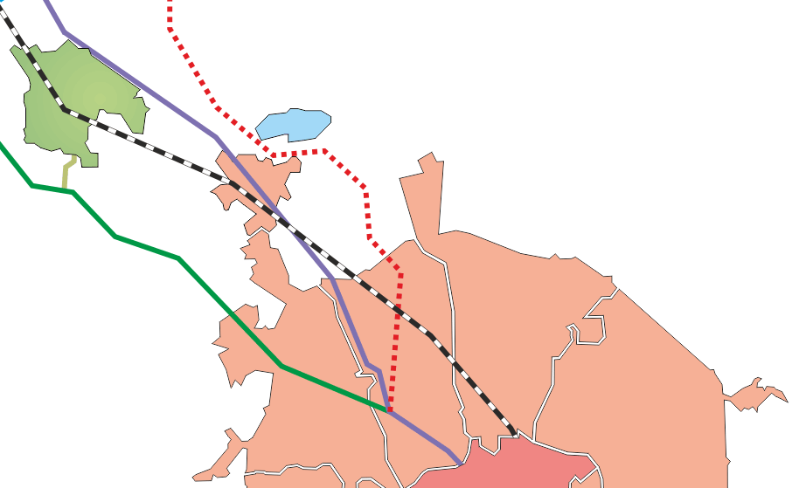



Location
Innovative technology cluster “Zelenograd”
(Moscow, Zelenograd)
Zelenograd district:
Total area – 3720 hectares, population – 229 600, industrial personnel – 23 000
60% of the population has higher education , more than 1 000 graduates annually
MOSCOW
Pyatnitskoe highway
Octyabrskaya Railway
Leningradskoye highway
New Leningradskoye highway (under construction)
Sheremetyevo Airport

Slide 3
Strong starting position of the cluster:
High-tech ecosystem in Zelenograd
>140
- Cluster members
Business Incubator
Historical role of the Russian Silicon Valley more than 50 years of specialization in the production of microelectronics and equipment
Infrastructure
SEZ
Largest and most modern production of microchips in Russia: №1 on market of microchips, RFID, modules for space equipment
Techno - park
Cluster
Fabless
MCST, Milandr, Navis, NPK TC, KM211, SovtestMicro
MIET
The profile
university
CCU
Precision assembly
Business
Science
Foundry
Mikron, Angstrem
R&D
IPPM RAS, NIIMV, VOIR

Slide 4
System of management and coordination
Government of Moscow
Federal ministry
Department of science industrial policy and entrepreneurship
Ministry of economic development of Russia
30%
70%
Council of the Cluster
Financial support of areas of innovation
Specialized organization Zelenograd Development Corporation
Council of experts
Council of science and technology
Working groups:
Technologies, marketing, investments, and staff
Providing support of cluster members’ activities and projects
Cluster participants (>140 participants)

Slide 5
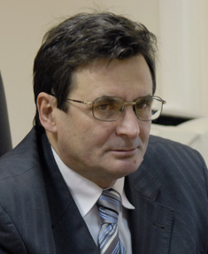
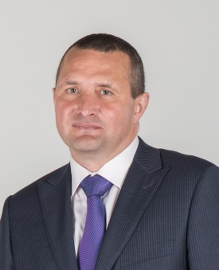
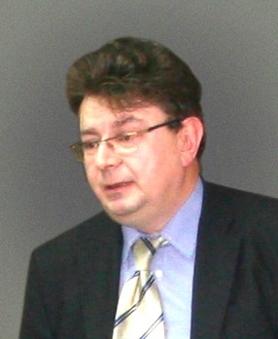
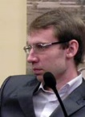
«Technounity» centers & services
Director of Technology
Development
Vladimir Leontyev
Chief Marketing Officer
Ilya Karpov
Director for Investment
Stanislav Dyba
Director for HR development
Yaroslav Melnikov
Technounity - Technology development
Technounity-Marketing
Technounity -Investments
Technounity-Human
Scientific and technical expertise of participants' projects
Products promotion
Investment expertise of participants' projects
Tracking of human resources needs and trainings
Initiating and support of innovative projects
Conducting PR activities
Selection of funding programs
Creating of database of young employees
Formation of scientific and technical cooperation
Organization of exhibitions and business missions
Organization of meetings with investors
Organization of training events
Providing of technology services
Marketing researches
Creation of project documentation
Providing resources of recruitment agencies

Slide 6
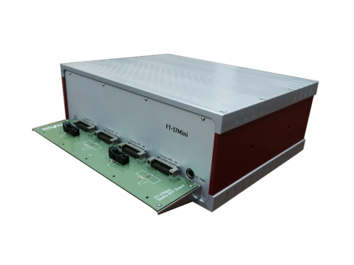
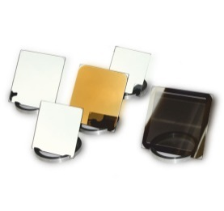

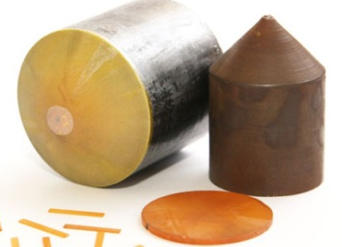
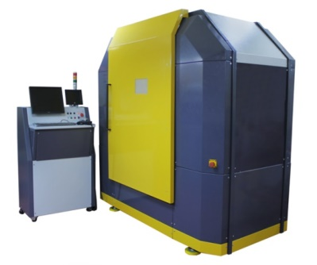
Service Platform
Start-up support, Project funding
Products and technologies promotion
Training, hosting symposiums & forums
International cooperation
Technology development
Public-private partnerships

Slide 7
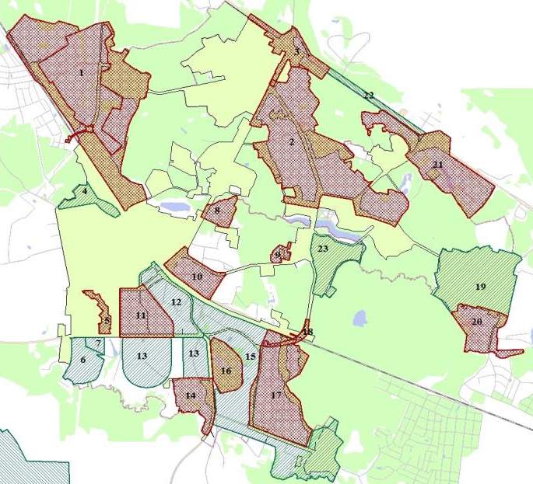

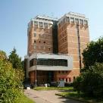
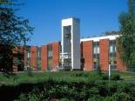
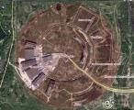
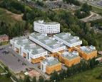
Infrastructure: an ecosystem for innovation
SEZ
Territory 146 he
Income – €128 million
Jobs - 827
Zelenograd district:
Total area – 3720 ha, Population – 229 600, industrial personnel – 23 000
60% of the population have higher education , More than 1 000 graduates annually
Business Incubator
Building area - 6670 m²
Income - €2,5 million.
Jobs - 200
Educational and innovative infrastructure NR UET
Manpower, R&D
Technopark
Territory 12 he
Area 108 000 m²(plan)
Area 25 112 m²(fact)
Income - €40 million.
Jobs - 3000
Industrial park (plan)
Territory 61,9 he,
Building area 640 000 m²
Jobs - 17000

Slide 8
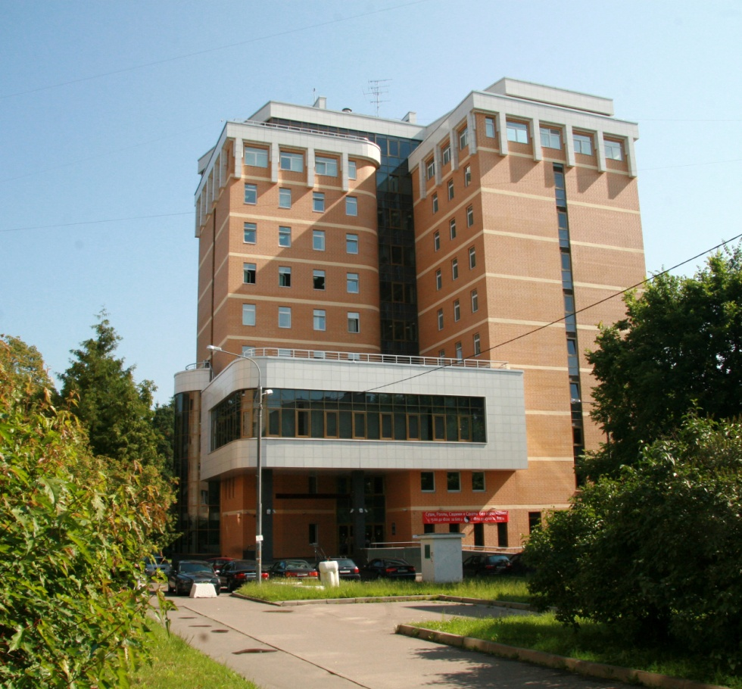
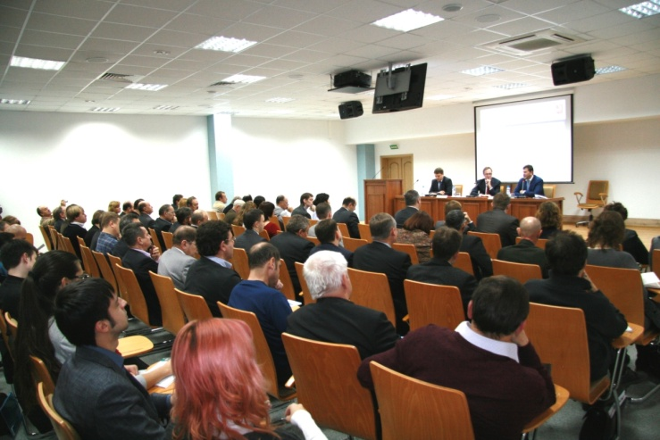
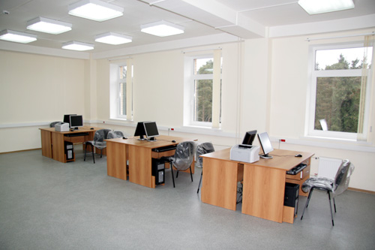
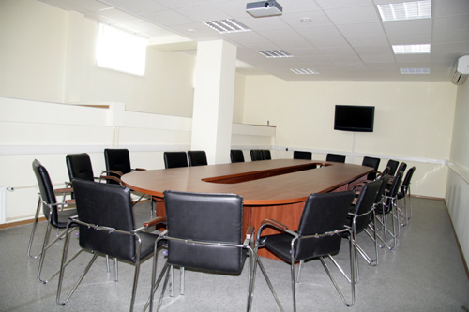
Business Incubator
The idea - a platform for young companies rapid development
Total area
– 0,2 He
The annual rental rate,
all inclusive
(depending on the stay length)
Volume Lease incentives for 2009 - 2014 г.
€ 0,7
million
Entire building
– 6700 sq. m.
1-st year
120 €/m²
2-nd year
150 €/m²
3-rd year
200 €/m²
In total for 2009 - 2014 years employed 636 highly qualified staff (developers, design engineers)
Business incubator
– 3100 sq. m..
Equipped office space from 11 to 150 m²
Pre-Incubator for 20 workplaces (150 m²)
Co-working for 20 jobs and public events hall (300 m²)
Conference hall (160 seats)

Slide 9
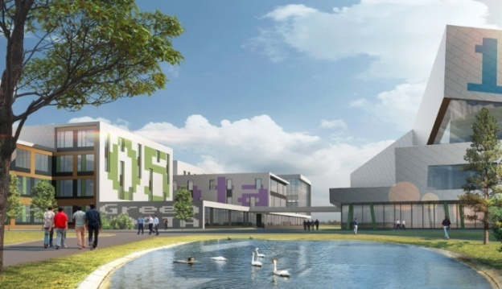
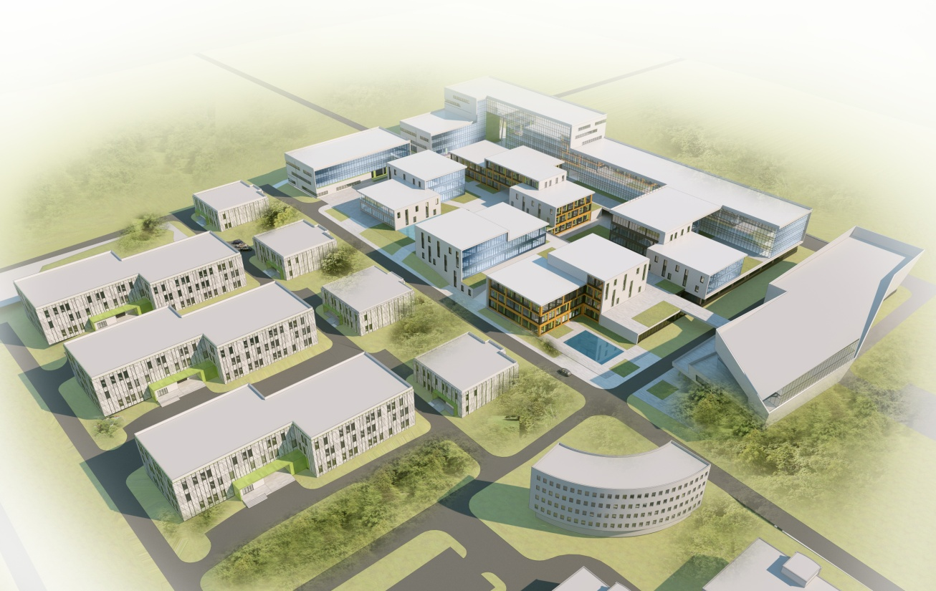
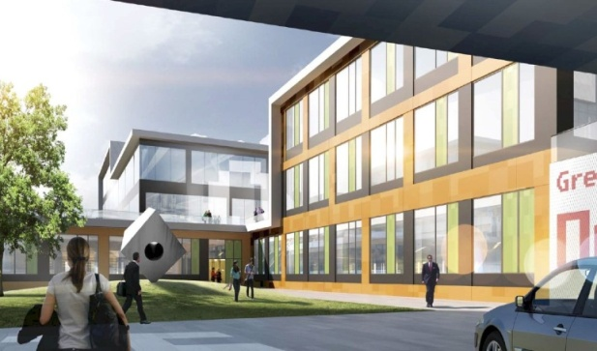
Technopark Zelenograd
The main purpose is to create the environment for development of innovative entrepreneurship
3
Proceeding
2
4
Ready
1
Total area
12 hectare
The total construction area of ​​108 thousand m²
All communications included
Total construction investment of up to 145 million Euros
Radio electronics, instrumentation, energy
Navigation, aerospace technology
Automation, control systems and resource accounting
Electronic components and equipment
Medical equipment, training equipment
IT, telecommunications

Slide 10
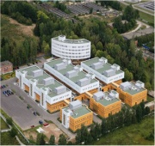
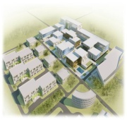
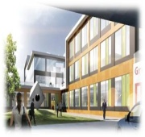
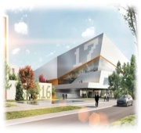
Technopark construction plan
State funding, loans, investors
Construction stages
Five-storied administrative building to accommodate:
- Managing Company's staff and engineering functions.
- Public premises.
- Offices of SME's businesses.
25 100 m² space
Three 3-storey industrial bldgs – 3x5860 m²
Four 2-storey research and production laboratories – 2x1262 m²
Multi-storey car park - 6700 m²
Cap. investments – €36,1 million
The area – 29400 m²
1 stage
Period – 2006-2009
2 stage
Period – 2015-2017
3 stage
Period — 2016-2018
4 stage
Period — 2017-2019
Stage 1
Stage 2
State funding, loans, investors
Loans, investors
Five 3-storey research and production laboratories – 17710 m²
Industrial building 3-6 floors - 27420 m²
Underground parking for 150 cars
Open parking for 148 cars
Cap. investments – €74 million
The area – 45130 m²
Community Center - 3470 m²
Storage building - 5210 m²
CHP - 1020 m²
Cap. investments – €34,1 million
The area – 9700 m²
Stage 3
Stage 4

Slide 11
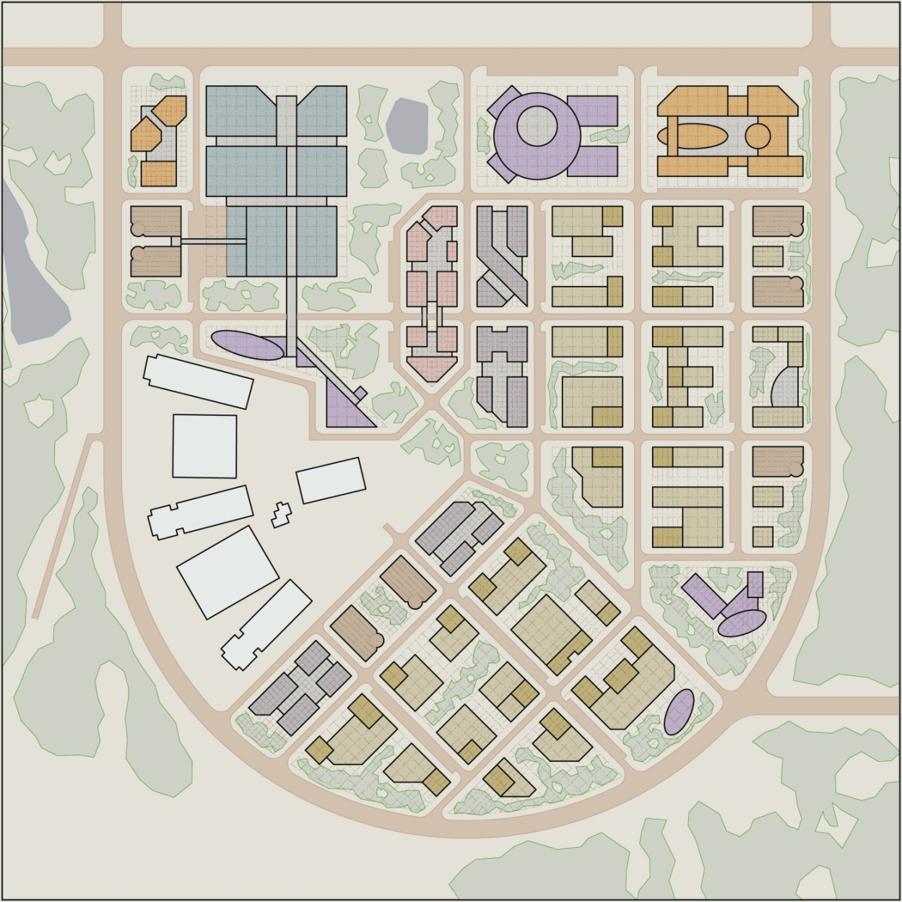
Innovation & industrial infrastructure
Industrial park Zelenograd
Industrial park - "growth point" of production with advanced logistics.
1
Industrial park general plan
2
4
3
BASIC TECHNICAL AND ECONOMIC INDICATORS (approximately)
10
7
9
10
212 t. m²
42 t. m²
29 t. m²
27 t. m²
90 t. m²
24 t. m²
428 t. m²
38 t. m²
18 t. m²
50 t. m²
252 t. m²
70 t. m²
640 t. m²
6
1.
2.
3.
4.
5.
6.
7.
8.
9.
10.
BUILDINGS URBAN INFRASTRUCTURE
Business center
Office building
Cultural and Sports Center
Shopping and entertainment center
Socio-cultural service
ENGINEERING AND TECHNOLOGY AREA
Branch technical college
A business incubator
Hotel Industry
Laboratory and pilot production
Above ground, underground parking
TOTAL
10
10
5
8.1
9
11
5
11
10
11
9
8.2
9
10
9
11
10
9
5
8.3
9
5
9
9
Jobs – 13000…17000

Slide 12
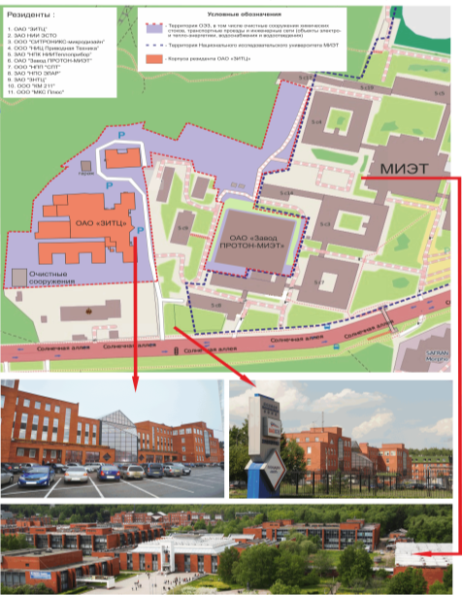
MIET university innovation infrastructure –
science and high-tech village
Technology village (SEZ area)
Total area, He | Buildings, m²
4,5 | 20 130,60
16
- Innovative companies
903
- jobs
0,3
- € billion investments
MIET University
The number of staff of the University - 1740
Doctors and professors - 118
PhDs and professors - 348
Doctoral students and post-graduate students - 280
Within the university
29 research and education centers, laboratories and centers of collective use, five new world-class
laboratories
Annual output - over 800 young specialists in the fields:
Electronics (micro, nano, opto)
Micro- and nano-system technics
Nanotechnology
Electronic engineering and instrument-making
biomedical systems
More than 30 thousand of MIET graduates of different generations

Slide 13
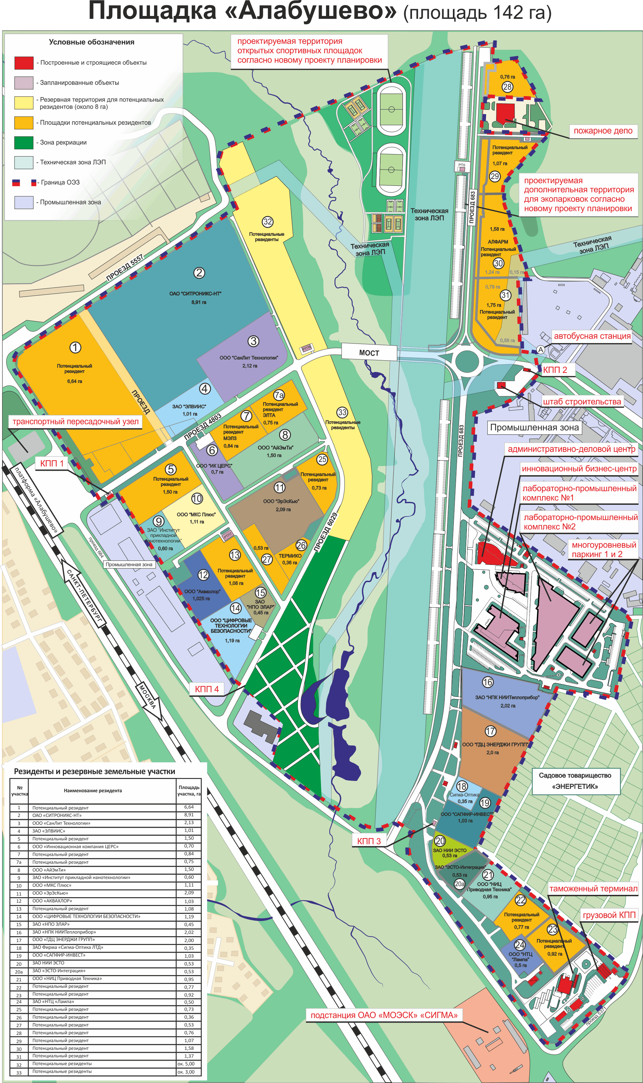
SEZ «Zelenograd» - «Alabushevo» Area
Tax and customs preferences,
government support for residents
Total area (rented / available)
Function use | Space, He
Leased by resident companies | 28,92
Infrastructure of SEZ "Zelenograd": onsite engineering networks and roads, office buildings, customs infrastructure, fire department | 35,73
Available to potential resident companies | 16,71
Natural complex, technical area of power transmission lines | 60,00
Provided electrification, water supply,
sewerage and heating

Slide 14
Preferential policy for residents
of Special Economic Zone
№ | Taxes | Zelenograd AI | Standard in Russia
1 | Profit tax | 13.5% | 20%
2 | Salary tax | 14% | 30.2%
3 | Property tax | 0% for 10 years | 2.2%
4 | Land tax | 0% for 5 years | 1.5%
5 | Transport and vehicles tax | 0% for 5 years | 12 – 150 thous. rub./year
6 | VAT | 0%¹ | 10 – 18%
7 | Customs duty | 0%² | Depending on item
Preferences on land lease. Reduction coefficient: 1st year – 0.4; 2d year – 0.5; 3d year – 0.6; 4th year (within next 5 years) - 0,7; after - 100%.
¹VAT – when exporting from Russia. When using the free customs zone terms - sales of goods are free of VAT.
²Customs preferences
- Imported goods are stored and used within the SEZ without payment of customs duties and VAT as well as other economic restrictions;
- Local goods are stored and used within the SEZ on terms applicable for export from Russia without payment of export duties;
- If removed from SEZ to other locations of Russia, VAT is applicable.

Slide 15
Example of using customs preferences
Resident of SEZ
(% in the share capital)
Creation of new
products / technology
Border
IMPORT
Customs duty – 0%
VAT – 0%
Goods,
components, equipment
EXPORT
VAT – 0%
New
products
DOMESTIC TRADE
VAT – standard
Border

Slide 16
Financial support for international innovative projects
“Internationalization“ State investors - Fund of Assistance
Fund of Assistance
Foreign Fund
The joint
project
R&D / OCD
< 300
thous. euro
50%
< 300
thous. euro.
50%
Russian small company
Foreign Partner
Object of funding
Bilateral development projects and the development of new types of high-tech products and technologies on the basis of belonging to these enterprises or public research organizations Intellectual Property
Conditions of financing
Financing on the basis of the signed between the Fund and foreign partners (foundations, ministries and other) agreements
Fund of Assistance financed the Russian company - up to 300 thousand. Euro. The Company is obliged to draw the same amount of extra-budgetary funds
Foreign fund financed by a foreign company. The Company is obliged to attract extra-budgetary funds

Slide 17
Financial support for international innovative projects
"Priority research and development” Russian Ministry of Education (RME)
RME
Foreign Partner
< 1
mln. euro
The joint
project
R&D
50%
Russian small company
Object of funding
- Research on promising directions of development of the world science;
- To study the possibility of future applications of multiple applications in various sectors of the economy;
- A unique high risk research in the future defining new possibilities for economic development
Conditions of financing
- Financing on an equal footing - 50% of the Ministry of Education (in the form of small grants of the Russian company), 50% of the foreign partner (the partner can be obtained from the funding agencies of the country)

Slide 18
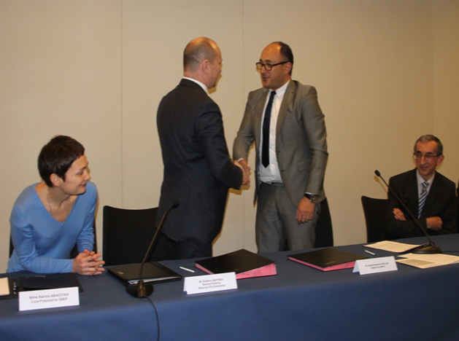
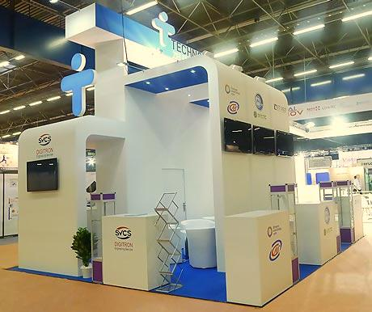
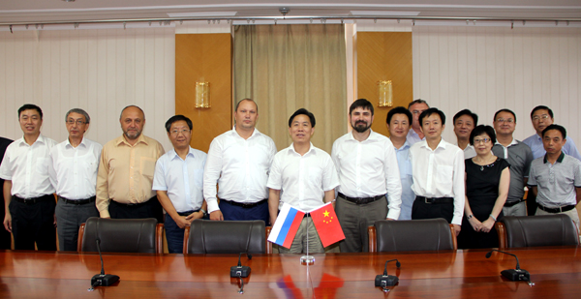
International cooperation
Cooperation agreement with the cluster Minologic, Grenoble, France;
Cooperation agreement with microelectronics cluster Silicon Saxony, Dresden, Germany which launched a joint scientific and technical activities;
Cooperation agreement between the National Research University MIET and French University of Joseph Fourier. Joint development of student satellite creation program;
Cooperation agreement with a High-Tech Development zone of East Lake Optical Valley, Wuhan, China.

Slide 19
«Technounity» cluster member companies competences
Nano - and micro-
Electronics
(Mikron, Milandr, Agstrem, Elvees, ZNTC)
Hardware and
Equipment
(Esto, NT MDT, Sovtest Micro)
IT-systems, wireless and telecommunication equipment
(Angstrem Telecom, Elins)
Biomedicine, medical equipment
(Altonika, Bioss, IUSS)
Design
R&D
Photomasks
Industrial gas
Materials
Epitaxy
Microelectronic devices
Equipment
Hardware
Sensors
IT- systems, electronics, control systems, automation
Telecommunication equipment
IT Systems Information Security
Medical equipment and systems
Biotechnology and Pharmaceuticals

Slide 20
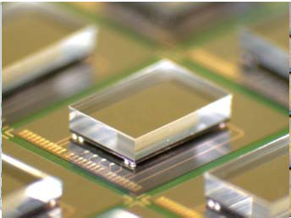
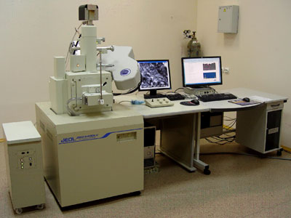
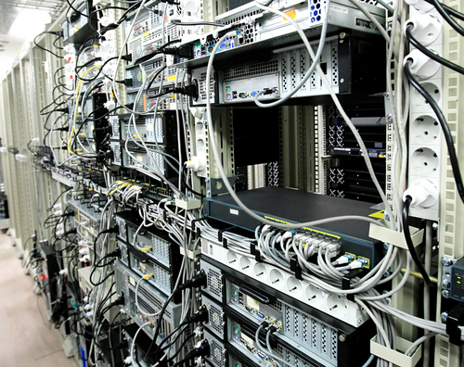
Development Projects
Examples of projects
The creation of a centre for advanced access to the latest core technologies for 3D integration of products of micro - and nanoelectronics and electronic devices based on them
The creation of a specialized diagnostic-metrological centre shared services research, diagnosis, measurement and testing parts warehouse, including in the nanometer range
Design Center of modern microelectronic components in remote access to centralized computing resources

Slide 21
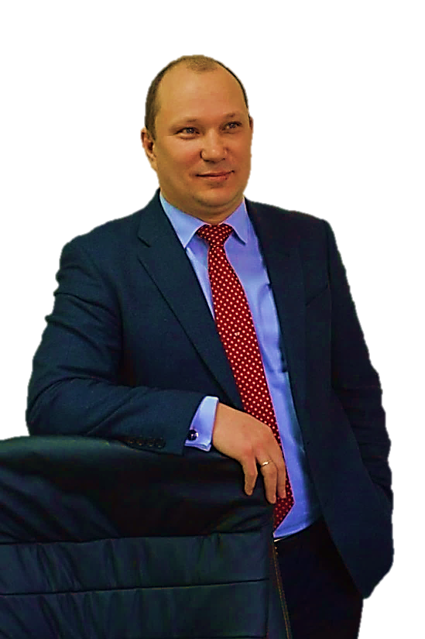
Thank you for attention!
Best Regards,
Vladimir Zaytsev
Director General
+7 (495) 989-10-51
info@technounity.com

